Slide 1

Food Pantries: Helping Families
Eat Healthier
Gina Osborne, RD
Nutrition Education & Obesity Prevention (NEOP)
September 5, 2017
This material was produced by the California Department of Public Health’s Nutrition Education and Obesity Prevention Branch with funding from the USDA Supplemental Nutrition Assistance Program - SNAP, known in California as CalFresh. These institutions are equal opportunity providers and employers. CalFresh provides assistance to low-income households and can help buy nutritious foods for better health. For CalFresh information, call 1-877-847-3663.
For important nutrition information, visit www.CaChampionsForChange.net.

Slide 2
What do families need?
Quantity of food
Quality of food
  Nutrition needs – Do you think families:
    Might have diabetes, be pregnant, have high blood pressure, high cholesterol, other?
    Need more soda, candy, ramen noodles & cranberry sauce?
    Need more F&V, whole grains & foods lower in sugar, salt & fat?
Notes:
Some things to think about and why it is important to link nutrition education to food pantries and clients

Slide 3
Overview
Talk about the strengths & needs of food pantries related to good nutrition.
Describe how to bring nutrition activities to food pantries.
Name 2 ways pantries can promote healthier foods.

Slide 4

Who is NEOP?
Nutrition Education & Obesity Prevention (NEOP)
Champions for Change
Funded by the USDA through
SNAP-Ed
Provide services to low-income
people in OC

Slide 5
Where does NEOP work?
Places where low-income people
Eat: or obtain food at no cost, food pantries, CalF offices, WIC clinics…
Live: community ctrs, public housing, churches ….
Learn: daycares, schools, after school programs, ….
Work: worksites
Play: parks, recreation, Safe Routes to School/Parks
Shop: retail grocery stores, Farmers Markets (pay)

Slide 6
NEOP + Second Harvest
EFAP (14 of 50)
Senior Grocery (30 of 33)
Kids Cafe (47)
School Pantry (21 of 32)
Summer Meals (some)

Slide 7
What does NEOP do?
Coordinate groups & meetings
  County Nutrition Action Plan (CNAP)
  Nutrition & Physical Activity Collab (NuPAC)
Needs assessments/ Training & TA
Nutrition Education
  Booths, food demos, displays, materials distribution, newsletters
  Single & series of classes
Policy, Systems & Environmental Changes (PSE) – easier to make & sustain healthy choices

Slide 8
What’s at Your Pantry?
Notes:
Shared at a Food Providers meeting. Raise your hand if seen it. Asks you questions like 1) most common F&V dist, 2) How often healthy and unhealthy foods dist …… Let me know if you want a copy – go to booth

Slide 9
What’s on a Label?
Trainings on various topics
Notes:
Help determine what foods are healthy. What does “healthy” mean? Feeding America has detailed “Foods to Encourage”.

Slide 10
What’s Donated?
Sample Policy:
Healthy Food
Donations
Notes:
At booth; also HCA sample policy

Slide 11
Handouts
Variety of topics
Based on client interests
Healthier ways to use foods
Notes:
At booth

Slide 12
Recipes
Featuring foods provided by the programs
EFAP, Senior Grocery & School Pantry

Slide 13
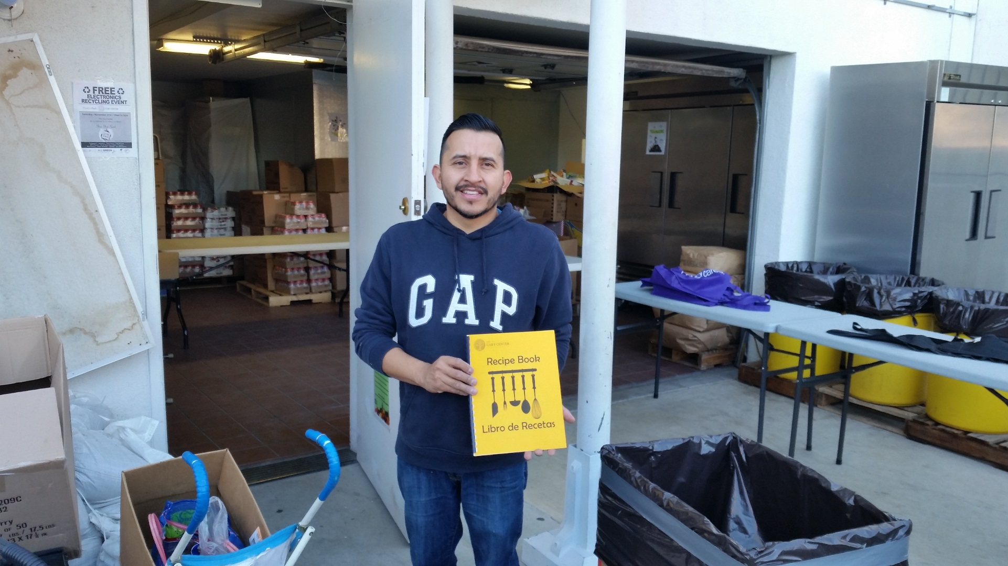
Recipes
The VCC/Gary Center, La Habra; Champion Oscar compiled recipes into a booklet.

Slide 14
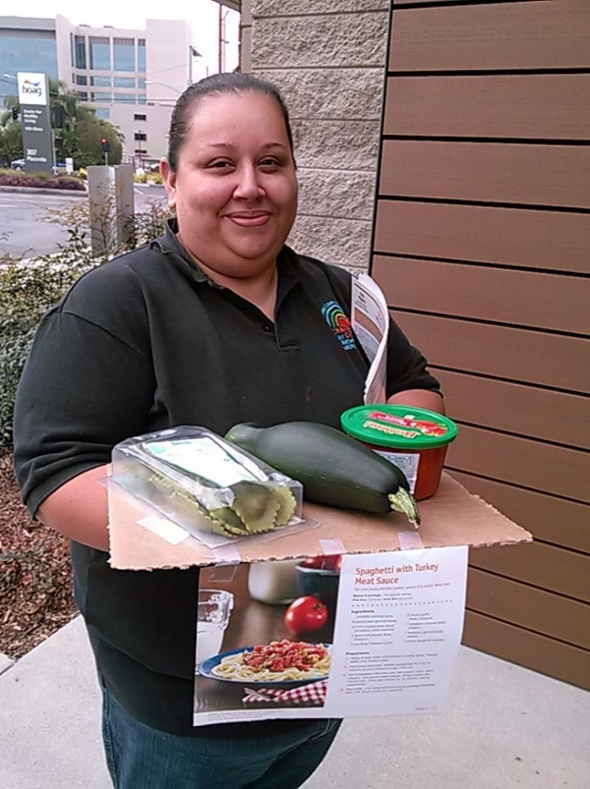
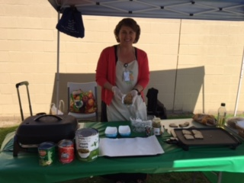
Food Demos
Help use foods in pantries
Demo recipes provided

Slide 15
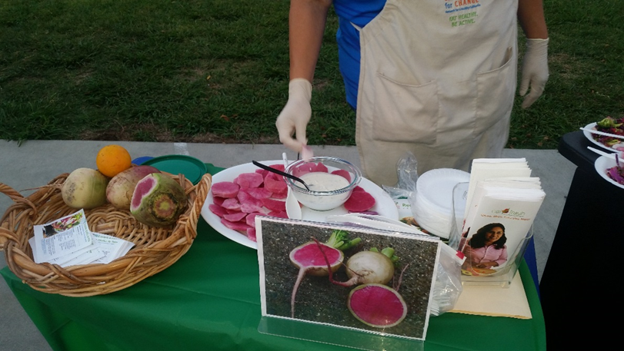
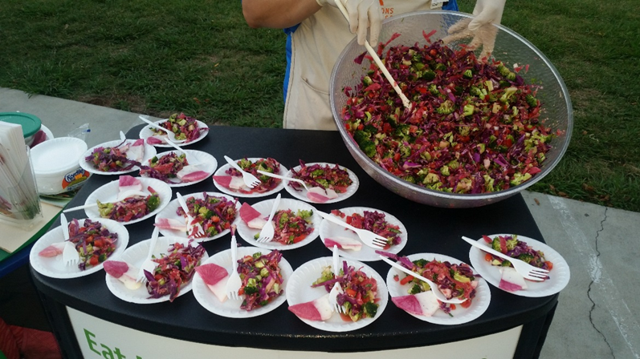
Food Demos
Watermelon Radishes
Make a Salad

Slide 16
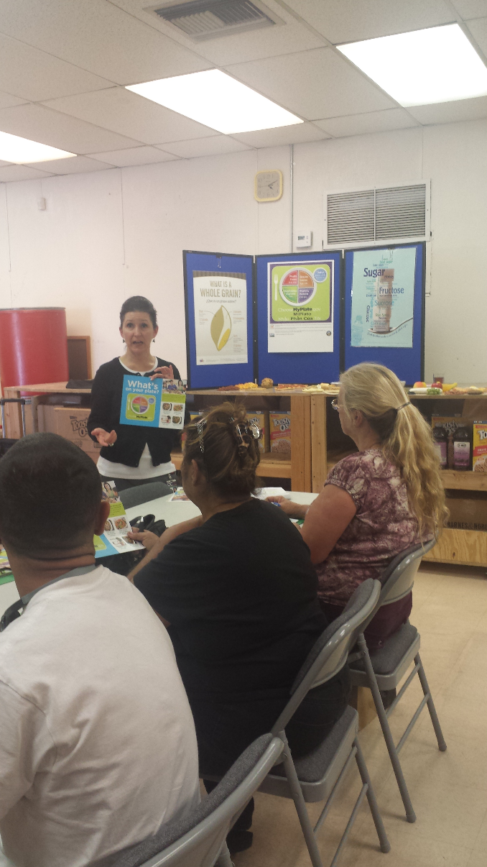
Classes
Series of classes or single classes
Youth & adults
National Nutrition Month Cards

Slide 17
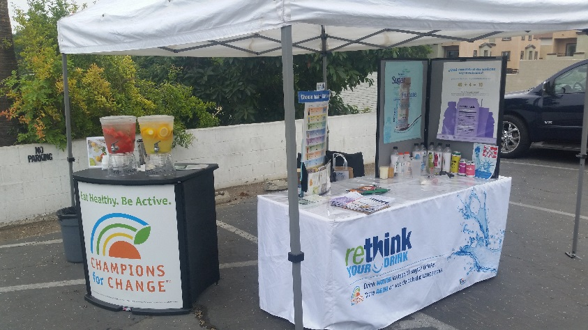
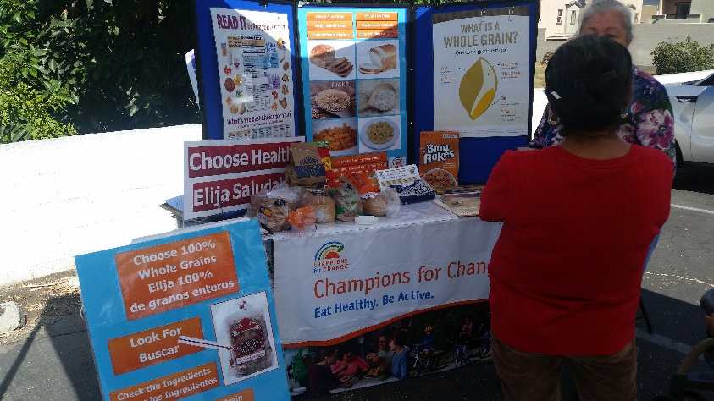
Booths
Various topics
Rethink Your Drink
Whole Grains

Slide 18
Evaluation

Slide 19
PSE
Policy Systems &
Environmental Changes

Slide 20


Swimming & Pools
Learn to swim
(education)
Place to swim
(PSE)

Slide 21
What is a PSE?
Policy – written statement of an organization’s position, decision or course of action
Systems – unwritten, ongoing organizational decisions or changes that result in new activities.
Environmental changes – Includes built or physical environment which are visual/observable but may include economic, social, normative or message environments.

Slide 22
Why do we have PSEs?
Complement education efforts
Help reach more people
Sustain healthy changes after education ends
Make the healthy choice the easy & preferred choice

Slide 23
Food Pantries
Education | PSE
Tip sheets, recipes, materials Staff trainings Booths & Demos Classes | Policy: Sample – Limit the number less healthy foods accepted & offered by the food pantry System: Work with partners to donate healthier foods Environment: Identify & promote the whole grain, lower sodium and lower sugar items available on site

Slide 24
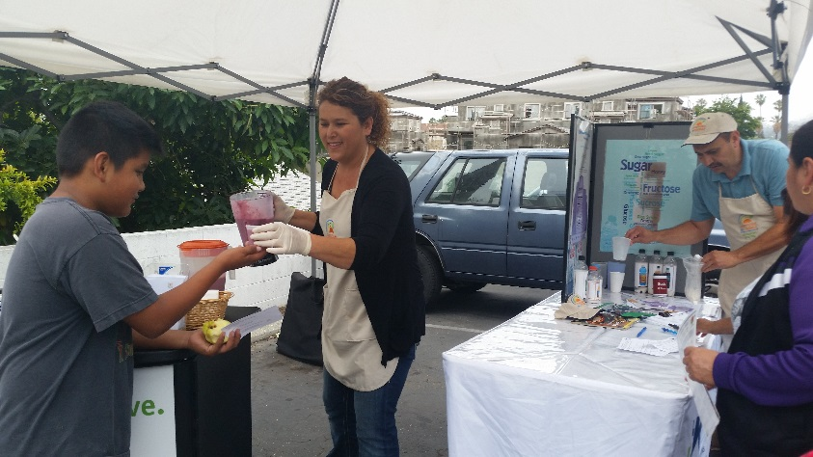
Healthy Food Donations
Healthier ways to use donated items
Notes:
Based on Feeding America’s Foods to Encourage & Second Harvest Most Needed Items list

Slide 25
Kids Café PSE
Goal: Increase consumption of suppers
4 pilot sites:
  Interviews with youth & staff
  Monthly tally sheets of menu items
  Continuous youth & staff feedback
  Taste tests
Results: Changes to menu, packaging & new recipes

Slide 26
Taste Tests

Slide 27
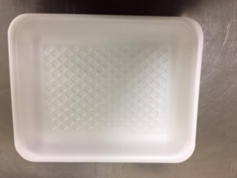
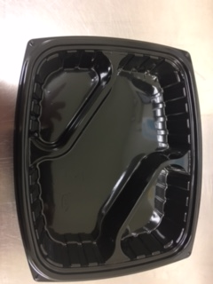
Packaging
Before
After

Slide 28
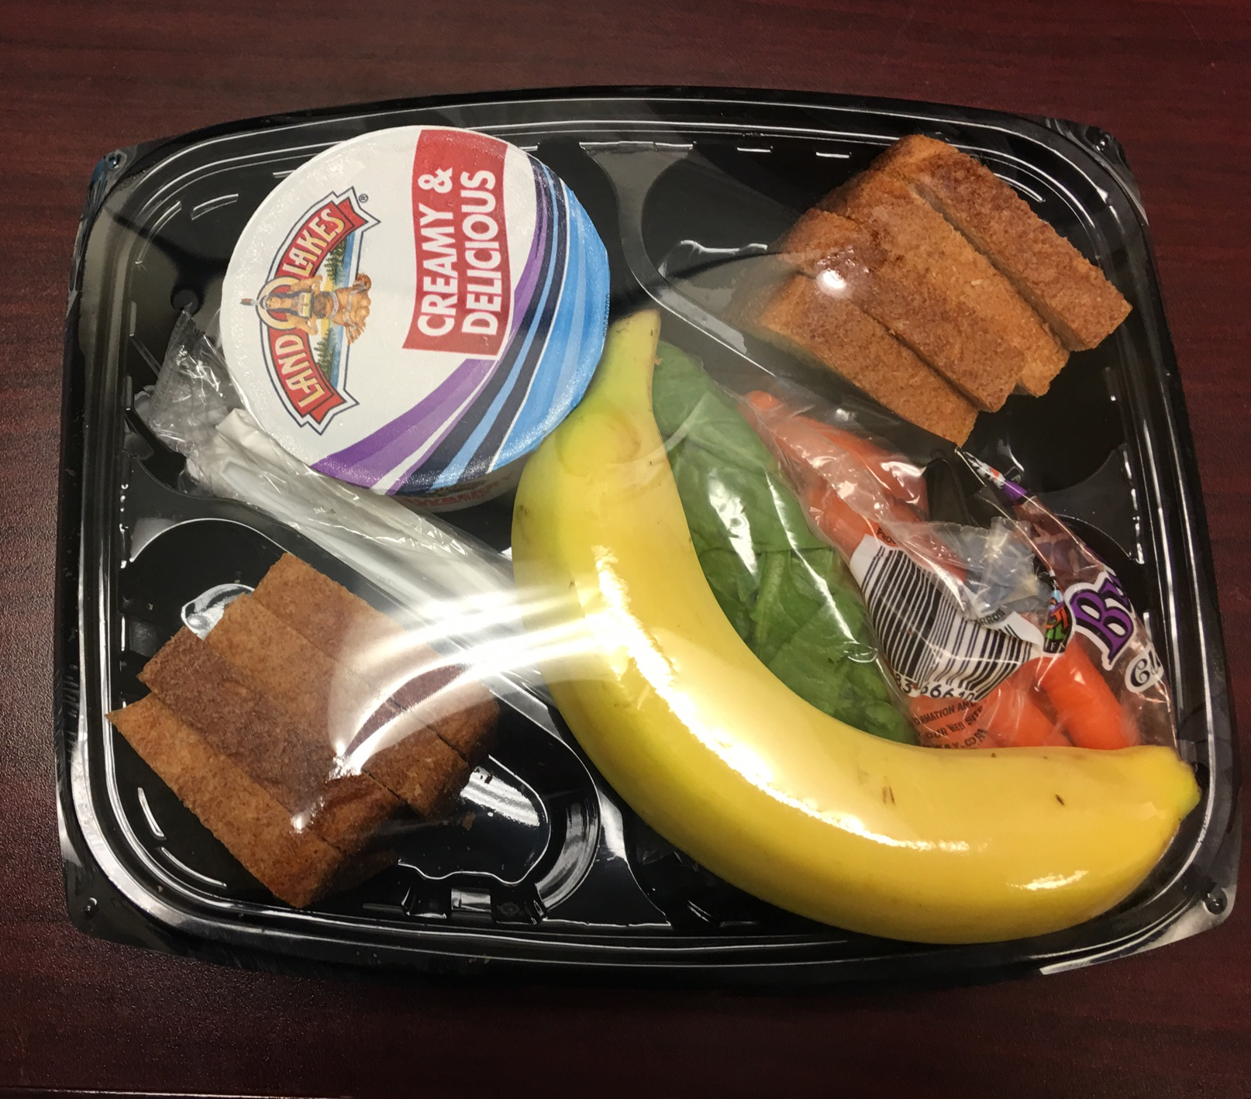
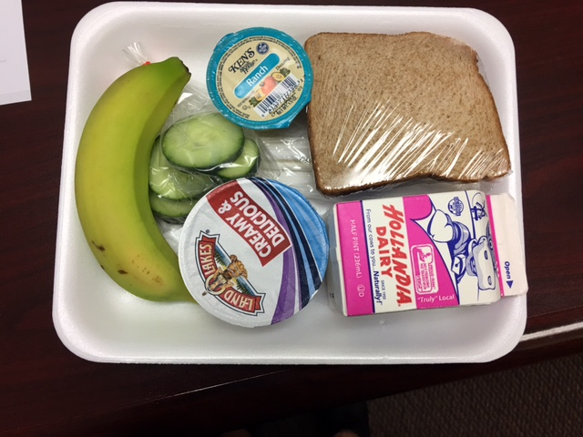
Menu Changes
A new look for Peanut Butter & Jelly

Slide 29
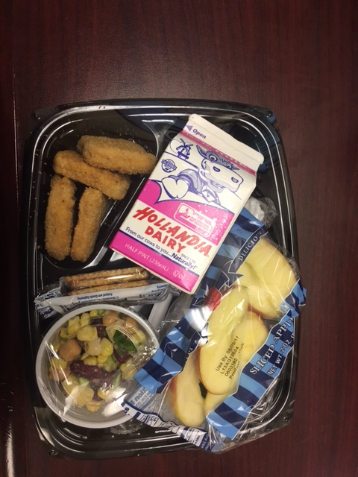
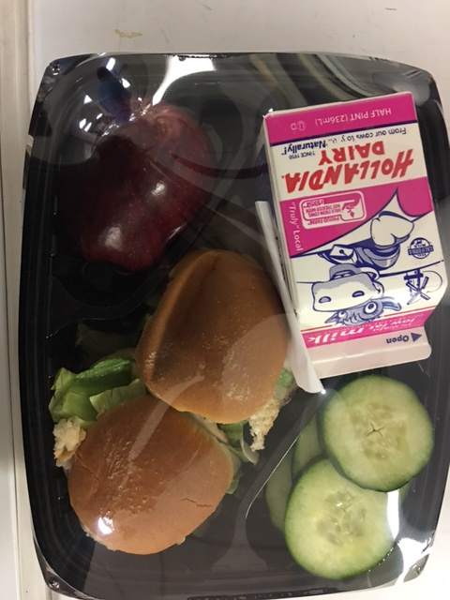
Menu Changes
Chicken Nuggets
Chicken Sliders

Slide 30
New Recipes
Kids Get Cookin’ cookbook

Slide 31
New Recipes
Mango & Black Bean Salad
Tajin for Vegetables

Slide 32

Partnering with NEOP
Role of NEOP
Provide nutrition education
Offer tech assistance
    (assess needs, train staff, engage partners, evaluate)
Role of Food Pantry
Identify barriers to making healthy choices
Adopt, maintain and enforce PSE changes
Contact: Gina Osborne – NEOP
(714) 834-8579 or gosborne@ochca.com

